Slide 1
Database Architectures Charles Severance

Slide 2
Database Normalization (3NF)
Usually
There is *tons* of database theory - way too much to understand without excessive predicate calculus
Do not replicate data. Instead, reference data. Point at data.
Use integers for keys and for references.
Add a special “key” column to each table, which you will make references to.
http://en.wikipedia.org/wiki/Database_normalization

Slide 3
To SQL or no to SQL? That is the question.. Or is it?

Slide 4
Relational or Not? Rows and Columns vs. Documents, Keys, and Values

Slide 5
ACID or BASE? Probably the best question to ask.

Slide 6
Atomicity
C
Consistency
I
Isolation
D
Durability
A
https://en.wikipedia.org/wiki/ACID

Slide 7
B
Basically
A
Available
S
Soft state
E
Eventual consistency
https://en.wikipedia.org/wiki/Eventual_consistency

Slide 8
https://en.wikipedia.org/wiki/ACID
X = 10
X: 42
What is X?
X = 20
https://en.wikipedia.org/wiki/Thymol_blue

Slide 9
https://en.wikipedia.org/wiki/ACID
X = 10
X: 20
What is X?
X = 20

Slide 10
https://en.wikipedia.org/wiki/ACID
X = 10
X: 10
What is X?

Slide 11
https://en.wikipedia.org/wiki/Eventual_consistency
X: 42@0
X = 10
X: 42@0
What is X?
X = 20
X: 42@0
https://en.wikipedia.org/wiki/Thymol_blue

Slide 12
X: 42@0
X = 10
X: 10@1
What is X?
X = 20
X: 42@0

Slide 13
X: 42@0
X: 10@1
What is X?
X = 20
X: 20@2

Slide 14
X: 42@0
X: 10@1
What is X?
X: 20@2

Slide 15
X: 10@1
X: 10@1
What is X?
X: 20@2

Slide 16
X: 20@2
X: 10@1
What is X?
X: 20@2

Slide 17
https://en.wikipedia.org/wiki/Eventual_consistency
X: 20@2
X: 20@2
What is X?
X: 20@2
https://en.wikipedia.org/wiki/Thymol_blue

Slide 18
Database Software
ACID (Atomic)
Oracle
PostgreSQL
MySQL
SQLite
SQLServer
BASE (Eventual)
Mongo
Casandra
BigTable

Slide 19
Compromises
ACID (Atomic)
SERIAL INTEGER keys
Transactions
UNIQUE Constraints
"One perfect SQL Statement"
BASE (Eventual)
GUIDs – Globally Unique IDs
Design for stale data in application
Application post-check and resolve
Retrieve and throw away

Slide 20
Scaling ACID Databases Why did we look at BASE at all?

Slide 21
Vertical Scaling
More disk drives or disk arrays / RAID
More processors
More memory
Switch from spinning to solid state drives
Modern SSD drives have scatter / gather
Has been solidly successful over the years

Slide 22
Master / Read Only Replicas
S Q L
R O U T E R
INSERT
UPDATE
READ/LOCK
BEGIN
Master
Database
Transaction
Log
SQL
Replica
Database
SELECT
JOIN
COUNT
…
Replica
Database

Slide 23
Multi-Master
S Q L
R O U T E R
Master
Database
Transaction
Log
INSERT
UPDATE
READ/LOCK
BEGIN
SQL
Master
Database
Transaction
Log
SELECT
JOIN
COUNT
…
Replica
Database
Replica
Database

Slide 24
Multiple Store Types
A
P
P L I C A T I O N
Master
Database
SQL
id | blob
1 | a6fed54
2 | 097de19
File System
open()
a6fed54
097de19

Slide 25
Multi-Tenant / "Pretend Cloud"
A
P
P L I C A T I O N
Client1
Client2
Client3
Client4
…
Client1000
Client1001

Slide 26
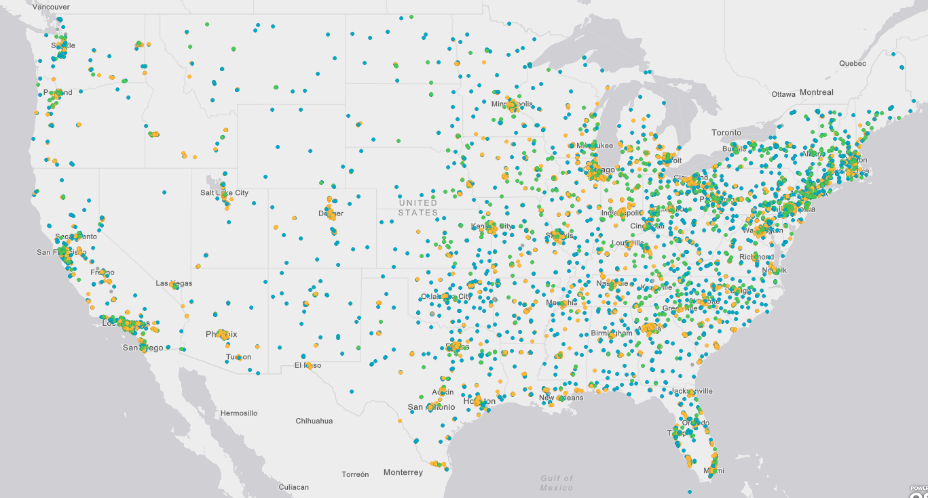
Email
2002
https://nces.ed.gov/ipeds/CollegeMap/

Slide 27
First Generation True Cloud Applications….

Slide 28
Email
2002
https://nces.ed.gov/ipeds/CollegeMap/

Slide 29
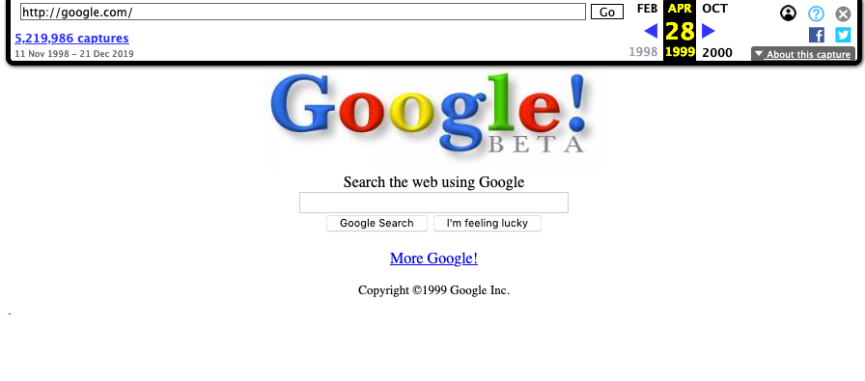
https://web.archive.org/web/19990428171538/http://google.com/

Slide 30
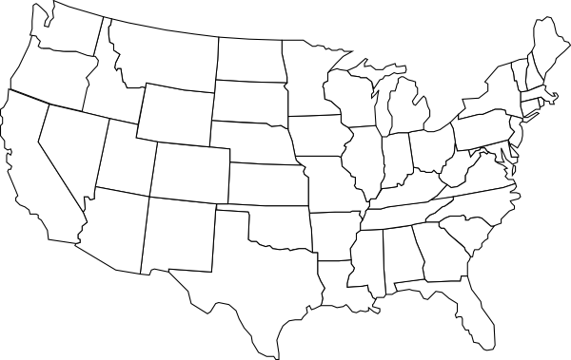
Email
2009

Slide 31
Google Could Not use RDBMS
They also chose applications that did not need transactions
Everything was free – or "the first ~100Mb was free"
Updates were widely distributed – even to email
Early Google Applications were not FaceBook or Twitter
They could use cleverly named files and folders and sharding / hashing across servers

Slide 32
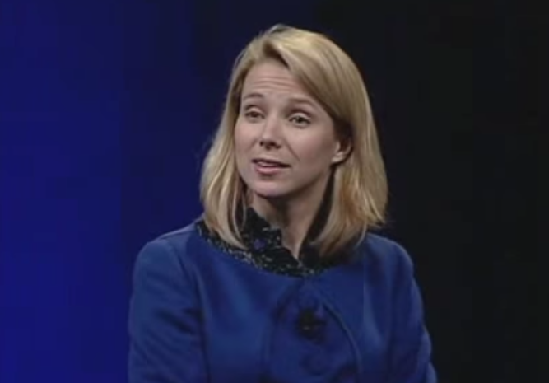
Searching / Scatter - Gather
Google I/O June 2008 Keynote
Marissa Mayer
https://www.youtube.com/watch?v=6x0cAzQ7PVs

Slide 33
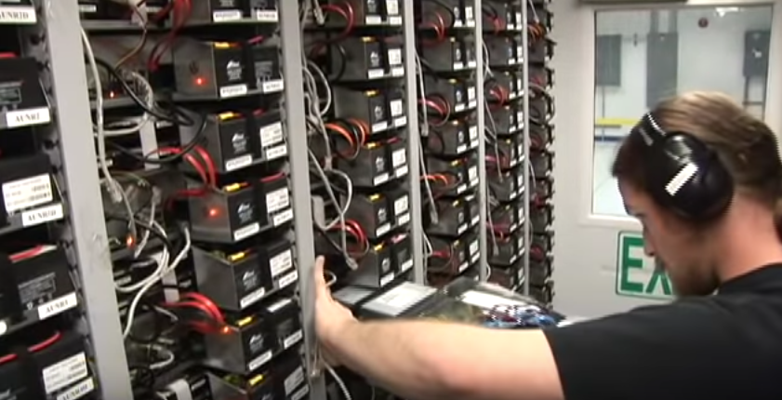
Google Container Tour
Google Efficient Data Centers Summit April 1, 2009.
https://www.youtube.com/watch?v=zRwPSFpLX8I

Slide 34
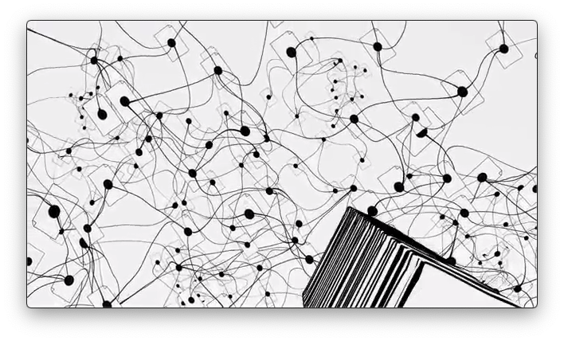
Google – How Search Works
Matt Cutts – March 2010
https://www.youtube.com/watch?v=BNHR6IQJGZs

Slide 35
Watch the Cloud Videos

Slide 36
Searching / Scatter - Gather
Google I/O June 2008 Keynote
Marissa Mayer
https://www.youtube.com/watch?v=6x0cAzQ7PVs

Slide 37
Google Container Tour
Google Efficient Data Centers Summit April 1, 2009.
https://www.youtube.com/watch?v=zRwPSFpLX8I

Slide 38
Google – How Search Works
Matt Cutts – March 2010
https://www.youtube.com/watch?v=BNHR6IQJGZs

Slide 39
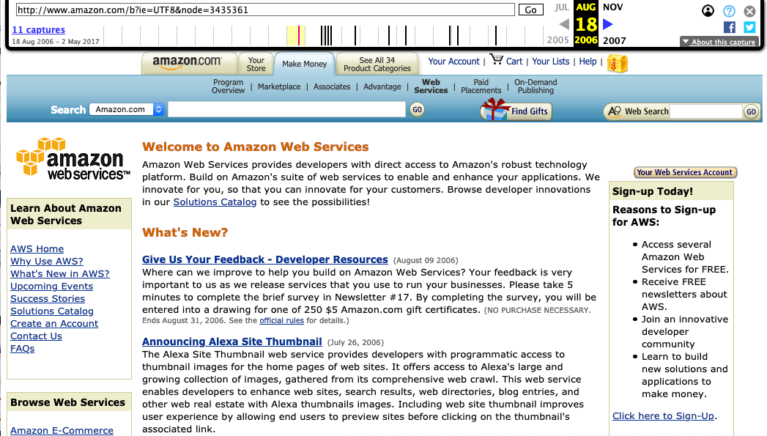
https://web.archive.org/web/20060818023744/http://www.amazon.com/b?ie=UTF8&node=3435361

Slide 40
Early Amazon Web Services Pricing
Large / slow disks were inexpensive
Small quick CPUs with small amounts of memory were inexpensive
Applications that responded to load by dynamically adding small servers and slow disk were ideal

Slide 41
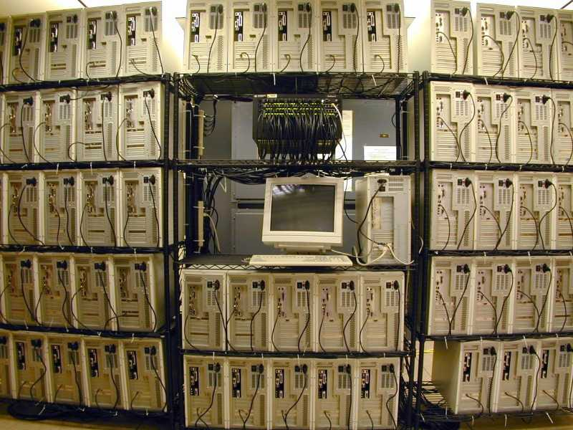
https://pages.mtu.edu/~steve/CSERI/

Slide 42
Efficient use of "carpet clusters"
Spread data out across many system
Scatter the query to all the systems
Gather the results
(a.k.a. Map-Reduce)
A single query might be 1-2 seconds
Many queries could be "in flight" at the same time (need a fast network)
You might just run a RDBMS on each node and shard

Slide 43
Second Generation Cloud Scale Applications

Slide 44
FaceBook is More Challenging
Friend lists – edit / add / drop / find
Privacy
Everyone sees a very different view
Everyone searches a different corpus
Data locking for predictable update is replaced by data sharding and replication
Migrate data "to be close" to the viewer

Slide 45
A-F
N-R
Annie
friends: Greg, Sarah
status
Greg: Pizza
Ron
friends: Greg
inbound: Ron
status:
Greg: Pizza
G-M
S-Z
Greg
friends: Annie, Ron
status:
Me: Pizza
Sarah
friends: Annie
outbound: Ron
status:

Slide 46
A-F
N-R
Annie
friends: Greg, Sarah
status
Greg: Pizza
Me: 👍
Ron
friends: Greg
inbound: Ron
status:
Greg: Pizza
G-M
S-Z
Greg
friends: Annie, Ron
status:
Me: Pizza
Sarah
friends: Annie
outbound: Ron
status:

Slide 47
A-F
N-R
Annie
friends: Greg, Sarah
status
Greg: Pizza
Me: 👍
Ron
friends: Greg
inbound: Ron
status:
Greg: Pizza
Annie: 👍 (??)
G-M
S-Z
Greg
friends: Annie, Ron
status:
Me: Pizza
Anne: 👍
Sarah
friends: Annie
outbound: Ron
status:
Greg: Pizza (??)
Annie: 👍 (??)

Slide 48
Problems to Solve
Clever non-locking solutions to distribution
GUIDs for primary keys
Hashing / Sharding for predictable data placement / lookup
Some central control – mostly "what is where"
Perhaps use one or more RDBMS for taking money or new accounts

Slide 49
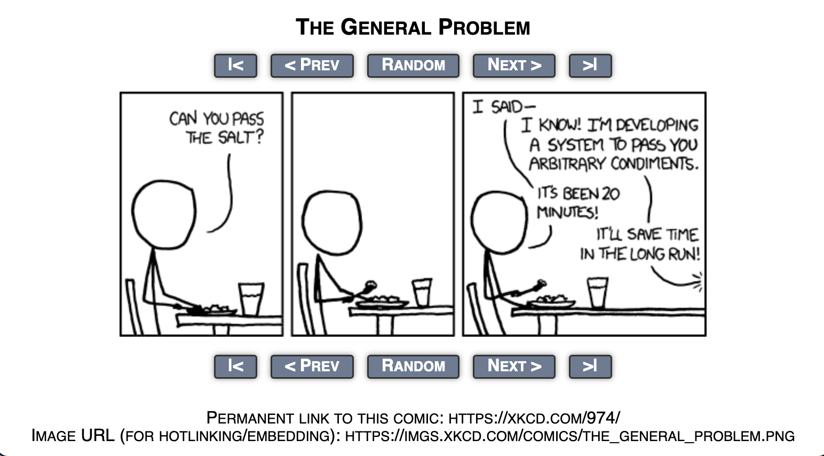
[[A person sits at a table, eating a meal.]]
Person: Can you pass the salt?
[[The person pauses, a bite of food on his fork, silently.]]
[[The person still has fork in mid-air.]]
Person: I said--
Off-screen Person: I know! I'm developing a system to pass you arbitrary condiments.
Person: It's been 20 minutes!
OSP: It'll save time in the long run!

Slide 50
The Emergence of BASE Solutions (i.e. NoSQL)

Slide 51
The basic principles of BASE DBMS
Everything is distributed – fast network
No locks (*)
Lots of fast / small memory CPUs
Lots of disks
Indexes follow data shards
Documents not rows / columns
Schema on read – not schema on write(*)

Slide 52
JSON Ascending
JSON is a great way to represent / move / store structured data
Fast parsers in every programming language
Easily compressed to save storage and transfer
{
"superlongkey" : 42;
}
{
"superlongkey" : 43;
}

Slide 53
Open Source NoSQL databases
CouchDB (2008)
Cluster Of Unreliable Commodity Hardware
MongoDB – 2009
Distributed JSON storage
Cassandra – 2008
From FaceBook
Also Apache Hadoop – Map / Reduce
ElasticSearch – 2010
Initially full text search Apache Lucene
Evolved into JSON database

Slide 54
Proprietary / Software AS a Service (SAAS) NoSQL Databases
Amazon DynamoDB
Backed the Amazon catalog
Google BigTable
Stored Google's copy of the web
Azure Table Storage
Catching up ☺

Slide 55
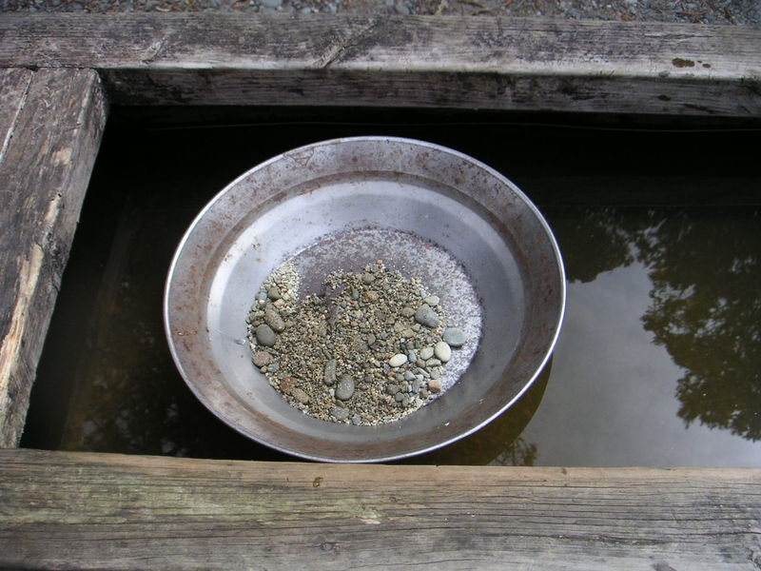
Every Startup 2010-Present
https://commons.wikimedia.org/wiki/File:Gold_Pan.jpg

Slide 56
Be like FaceBook – Make Money
Emergence of client-side applications
Backbone, Angular, React, Vue …
Emergence of JavaScript in the server
node.js – great at asynch / micro services
NoSQL databases
Distributed, scalable, inexpensive resources
Lots of startups / fresh ground up development

Slide 57
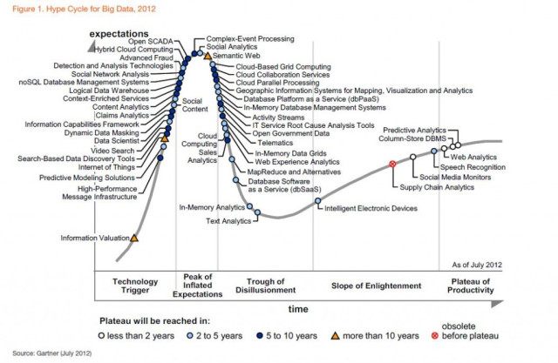
Gartner Hype 2012

Slide 58
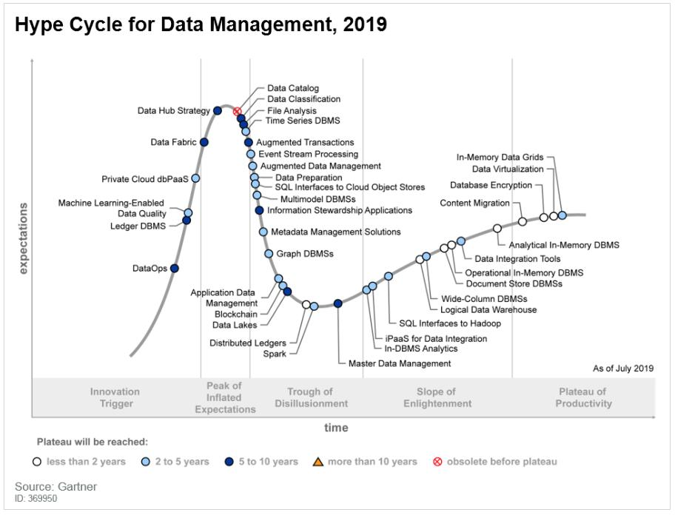

Slide 59
Case Study - Vericite
Startup founded in 2014 – expected 100TB
Cloud / multi-tenant / document based
Used MySQL for POC – Did not want to shard
Built on Cassandra and "owned hardware"
Cassandra fell down at scale - consultant
Switched to Amazon DynamoDB
Works – expensive but cheaper than consultants
NoSQL database competed against larger firm using custom storage on physical hardware

Slide 60
Reacting to the rise of NoSQL

Slide 61
But That's Not All…
The ACID vendors saw market share slipping away circa 2013
As NoSQL applications matured they found that application developers wanted "a few" transactions and JOINs
ACID + BASE became the new sweet spot

Slide 62
Technology Changes 2009-2019
AWS Could sell you 32 CPU systems with large amounts of RAM cheaper than you could own them
Solid State Disk developed scatter / gather on a single drive with 32 + simultaneous reads to different areas of the drive

Slide 63
RDBMS Vendors reacted
Oracle
JSON Columns
NoSQL Features
MySQL 8.0 – JSON Columns
PostgreSQL
8.3 HSTORE Columns (2008 and 2014)
9.2 JSON Columns (2012)
9.4 JSONB Columns (2014)
Amazon Redshift is based on a "modified" PostgreSQL 8.0 (2013)

Slide 64
ACID + BASE or BASE + ACID
It turns out to be easier to relax ACID than to do the research and development to implement ACID in a system that is distributed at its core
SQL does not imply ACID
BASE runtime databases are adopting SQL syntax for some of their operations to make it easier for developers

Slide 65
Hybrid (Hypothetical)
S Q L
R O U T E R
INSERT
UPDATE
READ/LOCK
BEGIN
ACID Master
Transaction
Log
SELECT
JOIN
COUNT
…
Read Replica
SQL
Read Replica
BASE
INSERT
UPDATE
BASE

Slide 66
Being BASE-Like in ACID RDBMS
Do not normalize – Replicate
Don't use SERIAL - use UUID
Columns are for indexing
Do not use foreign keys or don't mark them as such
Design your schema / indexes to enable reading a single row on query
https://www.wix.engineering/post/scaling-to-100m-mysql-is-a-better-nosql

Slide 67
Being BASE-Like in ACID RDBMS
Use software migrations instead of ALTER
Query for records by primary key or by indexed column
Do not use JOINs
Do not use aggregations (COUNT ??)
https://www.wix.engineering/post/scaling-to-100m-mysql-is-a-better-nosql

Slide 68
Summary
NoSQL is doing well
More for specialized applications
Less conversation about the "end of SQL"
Breathless is becoming pragmatic
There is a learning curve - production experience
SASS from cloud vendors makes it "easier"
Some applications converting back
"Move from MongoDB to PostgreSQL"
Review: Why PostgreSQL for this course?

Slide 69
Acknowledgements / Contributions
These slides are Copyright 2019- Charles R. Severance (www.dr-chuck.com) as part of www.pg4e.com and made available under a Creative Commons Attribution 4.0 License. Please maintain this last slide in all copies of the document to comply with the attribution requirements of the license. If you make a change, feel free to add your name and organization to the list of contributors on this page as you republish the materials.
Initial Development: Charles R. Severance, University of Michigan School of Information
Insert new Contributors and Translators here including names and dates
Continue new Contributors and Translators here

